Slide 1
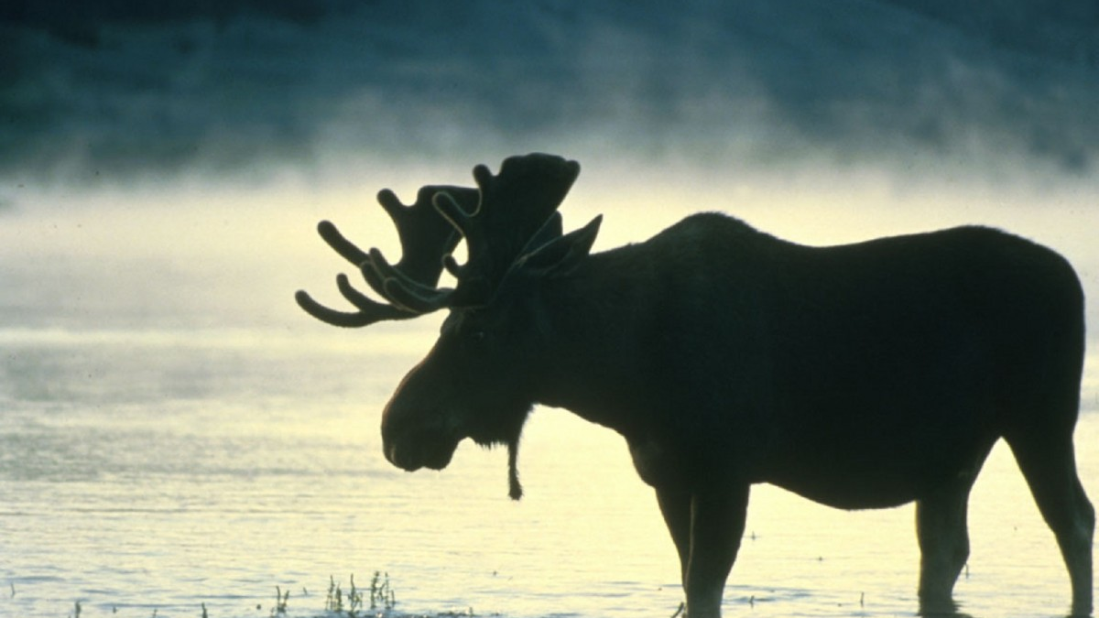
MEMORIAL SERVICE
WILLISTON MOOSE LODGE #239
REMEMBERING OUR DEPARTED BROTHERS AND SISTERS OF OUR LODGE
2023-2024

Slide 2
“When someone becomes a memory, the memory becomes a treasure.”

Slide 3
IN LOVING MEMORY
Earl M Aamoth Past Governor
Toni Axelson
Georgene Baustad – Past Regent
Dennis L. Bellet
Trish Broe
Maxine Duncalf
Hazel Engberg
Neal Falk
Frank A. Glimm
Terry Guill

Slide 4
IN LOVING MEMORY
Lavina Haarstad
Elaine Halvorson
Ronald D. Huag
Mike Hering
Arlene E. Hickel
Thomas C. Jacobson Past Governor
Jerome Langseth
Jordis Larvick Past Governor
Roberta Martin
Donald Nerhring

Slide 5
IN LOVING MEMORY
Mary Kay Odegard
Patricia Olson
Todd Panasuk
V. F. Peterson
Rita Schwan – Past Regent
Leroy “Barney” Seaton
Emma J. Thorson
Norris Weflen
Fred Whisenand Jr.
Thomas H White Past Governor

Slide 6
MEMORIAL SERVICE
WILLISTON MOOSE LODGE #239
REMEMBERING OUR DEPARTED BROTHERS AND SISTERS OF OUR LODGE
2023-2024

Slide 7
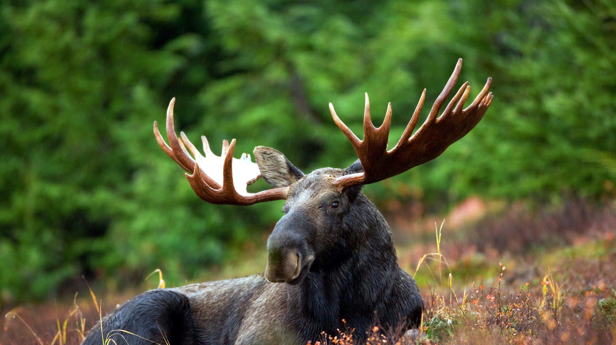
Thanks for coming to honor our departed Brothers and Sisters of the Williston Moose Lodge!

